Slide 1
DATA SCIENCE PROJECT
DST
By Abdul Muqtadir Ahmed

Slide 2
Problem Description
Big Mart Dataset(Super Market)
The data scientists at Big Mart had collected 2013 sales data for 1559 products
across 10 stores in different cities.

Slide 3
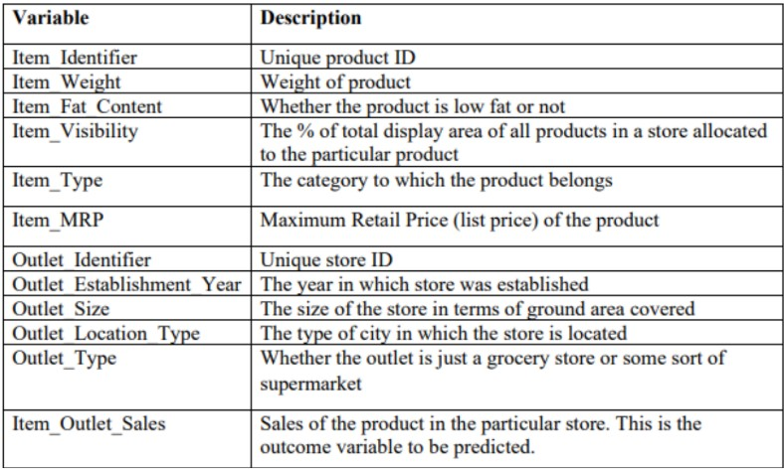
Attributes (No of Columns =12)

Slide 4
 | Item_Identifier | Item_Weight | Item_Fat_Content | Item_Visibility | Item_Type | Item_MRP | Outlet_Identifier | Outlet_Establishment_Year | Outlet_Size | Outlet_Location_Type | Outlet_Type | Item_Outlet_Sales
0 | FDA15 | 9.300 | Low Fat | 0.016047 | Dairy | 249.8092 | OUT049 | 1999 | Medium | Tier 1 | Supermarket Type1 | 3735.1380
1 | DRC01 | 5.920 | Regular | 0.019278 | Soft Drinks | 48.2692 | OUT018 | 2009 | Medium | Tier 3 | Supermarket Type2 | 443.4228
2 | FDN15 | 17.500 | Low Fat | 0.016760 | Meat | 141.6180 | OUT049 | 1999 | Medium | Tier 1 | Supermarket Type1 | 2097.2700
3 | FDX07 | 19.200 | Regular | 0.000000 | Fruits and Vegetables | 182.0950 | OUT010 | 1998 | NaN | Tier 3 | Grocery Store | 732.3800
4 | NCD19 | 8.930 | Low Fat | 0.000000 | Household | 53.8614 | OUT013 | 1987 | High | Tier 3 | Supermarket Type1 | 994.7052
... | ... | ... | ... | ... | ... | ... | ... | ... | ... | ... | ... | ...
8518 | FDF22 | 6.865 | Low Fat | 0.056783 | Snack Foods | 214.5218 | OUT013 | 1987 | High | Tier 3 | Supermarket Type1 | 2778.3834
8519 | FDS36 | 8.380 | Regular | 0.046982 | Baking Goods | 108.1570 | OUT045 | 2002 | NaN | Tier 2 | Supermarket Type1 | 549.2850
8520 | NCJ29 | 10.600 | Low Fat | 0.035186 | Health and Hygiene | 85.1224 | OUT035 | 2004 | Small | Tier 2 | Supermarket Type1 | 1193.1136
8521 | FDN46 | 7.210 | Regular | 0.145221 | Snack Foods | 103.1332 | OUT018 | 2009 | Medium | Tier 3 | Supermarket Type2 | 1845.5976
8522 | DRG01 | 14.800 | Low Fat | 0.044878 | Soft Drinks | 75.4670 | OUT046 | 1997 | Small | Tier 1 | Supermarket Type1 | 765.6700

Slide 5
Problem Statement
The aim is to (visualize data) get insights from the dataset. Try to understand the how various features play a role in increasing the sales.
Predict the sales of product from different stores(Item_Outlet_Sales Variable).

Slide 6
Data Cleansing
The Null values from item weight were replaced with the mean of the item_weight variable (i.e 12.847).
The Null values of Outlet_Size were dropped.
Also used Label Encoding at several places to change few Object Data Type to Integer Data Type.

Slide 7
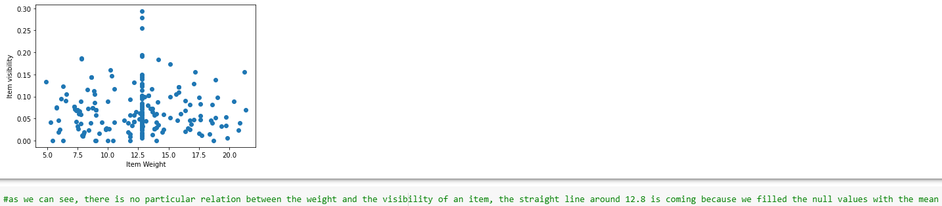
Data Visualization
Visualized the data using matplotlib library, using different plots.

Slide 8
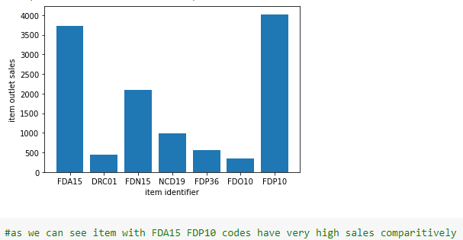
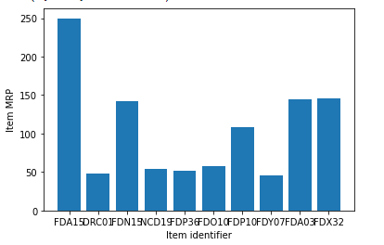

Slide 9
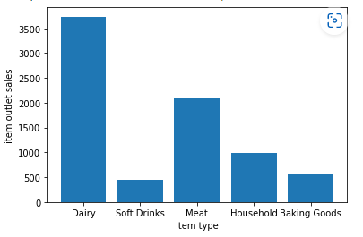
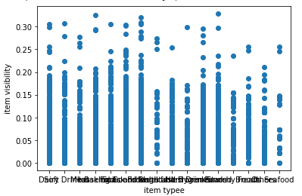
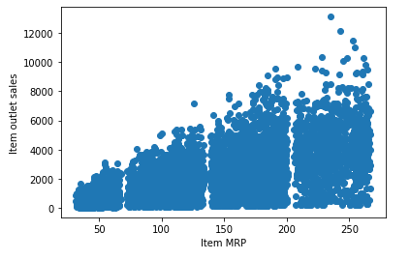
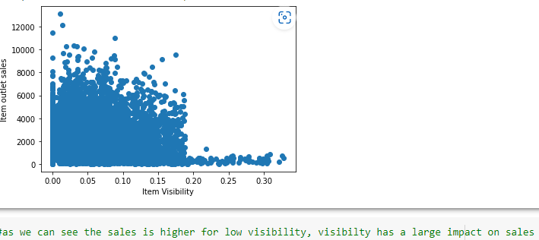

Slide 10
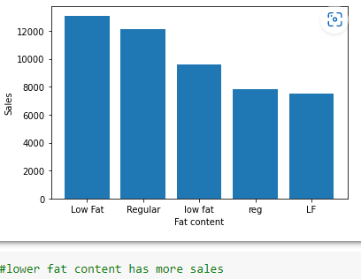
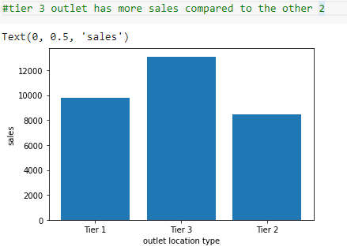
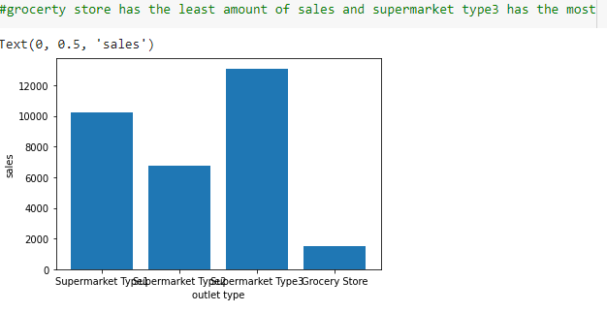

Slide 11
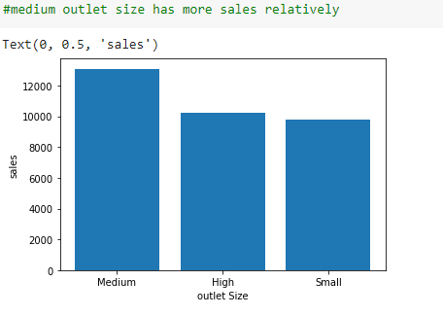
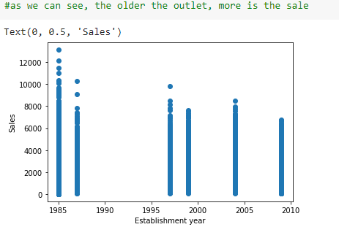

Slide 12
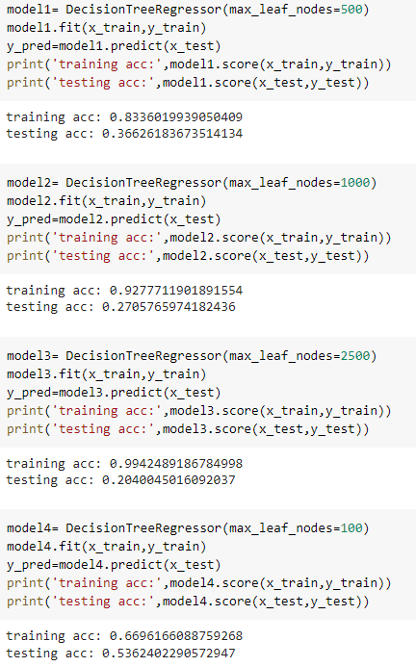
Model Building
Model used - DecisionTreeRegressor()
(from sklearn.tree – model selection ~ test_train_split.)
Y is the variable to be predicted(item outlet sales).
X is all the other attributes except item outlet sales.

Slide 13
Conclusion
If we take the value of max leaf nodes small, the difference between training and testing accuracy is less.

